Slide 1

WebAssembly
(also known as)
Wasam

Slide 2

What is WebAssembly ?
Why is it important?
Where has it been used?
What is its possible future impact?

Slide 3
What is WebAssembly ?

Slide 4
Why is it important?

Slide 5



Where has it been used?

Slide 6

Where has it been used?

Slide 7

Where has it been used?
“WebAssembly cut Figma's load time by 3x”

Slide 8
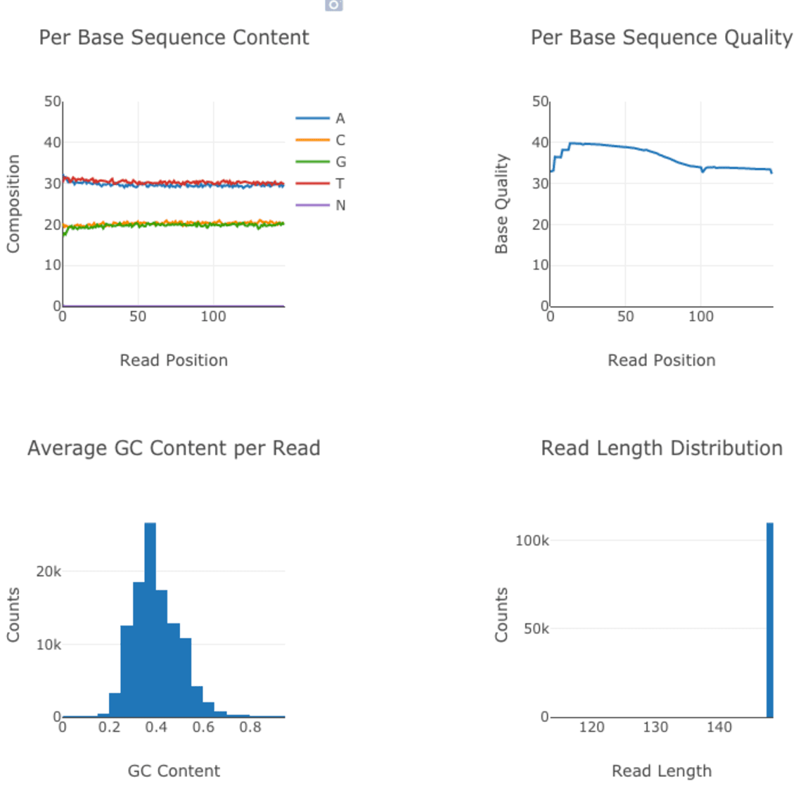
Where has it been used?
How We Used WebAssembly To Speed Up Our Web App By 20X (Case Study)
fastq.bio provides scientists with a quick preview of the quality of their DNA sequencing data

Slide 9

What is its possible future impact?
Pyodide
...we’re meeting data scientists where they are by bringing the popular and mature Python scientific stack to the browser.

Slide 10
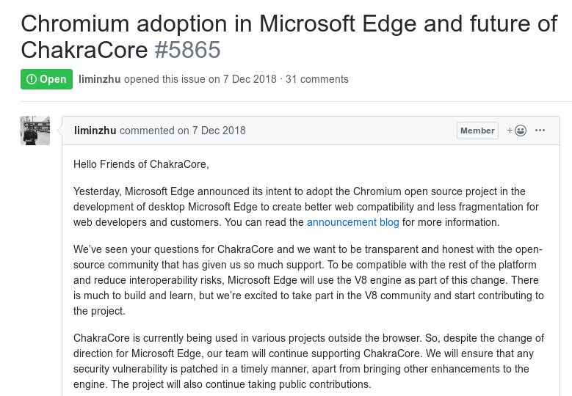
What is its possible future impact?

Slide 11


What is WebAssembly ?
Why is it important?
Where has it been used?
What is its possible future impact?

Slide 12


